Slide 1
nova(cam): TF coil and FW optimisation toolbox
S. McIntosh, M. Coleman

Slide 2
nova(cam): TF coil and FW optimisers
The original Nova code also contained many other aspects:
Equilibrium solver + coil optimiser
Coil CAD
ANSYS routines for forces, etc.
These are no longer used in BLUEPRINT
Superseded by other modules
Restructured / 80%+ rewritten

Slide 3
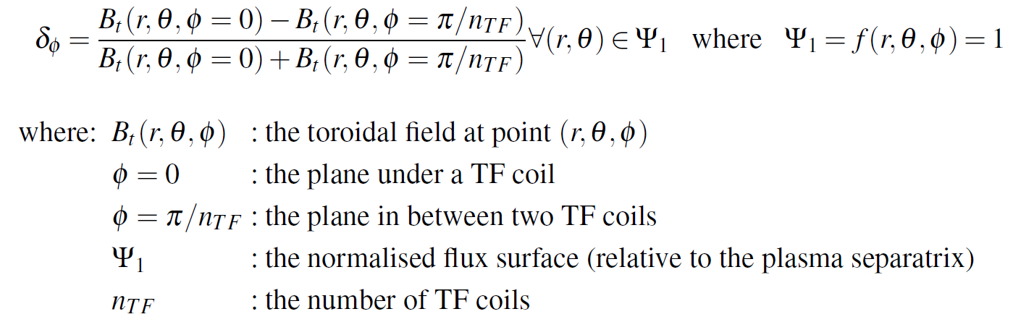
TF ripple
“TF ripple” is the variation in the toroidal field in the toroidal direction
Basically the relative ratio of the TF between a point under a TF coil and in between two TF coils
Causes alpha losses and other nasty physics things

Slide 4
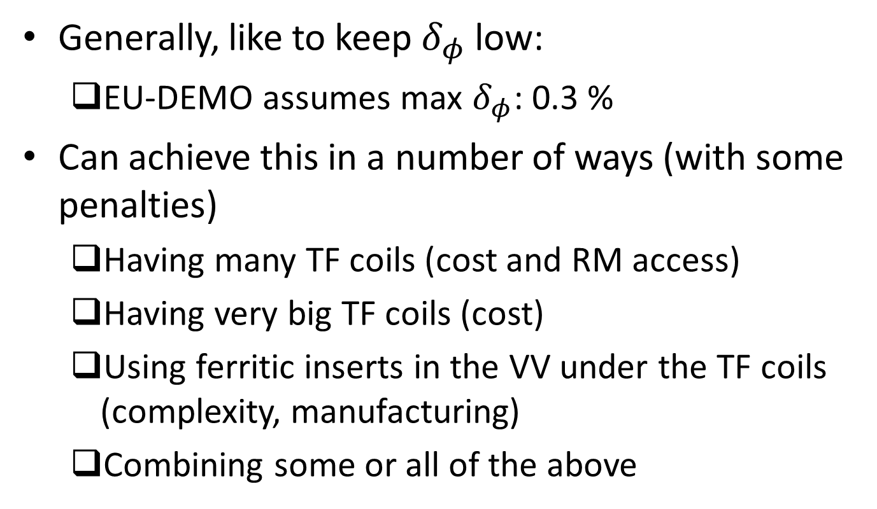
TF ripple constraint
Generally, like to keep $δ_{φ}$ low:
EU-DEMO assumes max $δ_{φ}$: 0.3 %
Can achieve this in a number of ways (with some penalties)
Having many TF coils (cost and RM access)
Having very big TF coils (cost)
Using ferritic inserts in the VV under the TF coils (complexity, manufacturing)
Combining some or all of the above

Slide 5
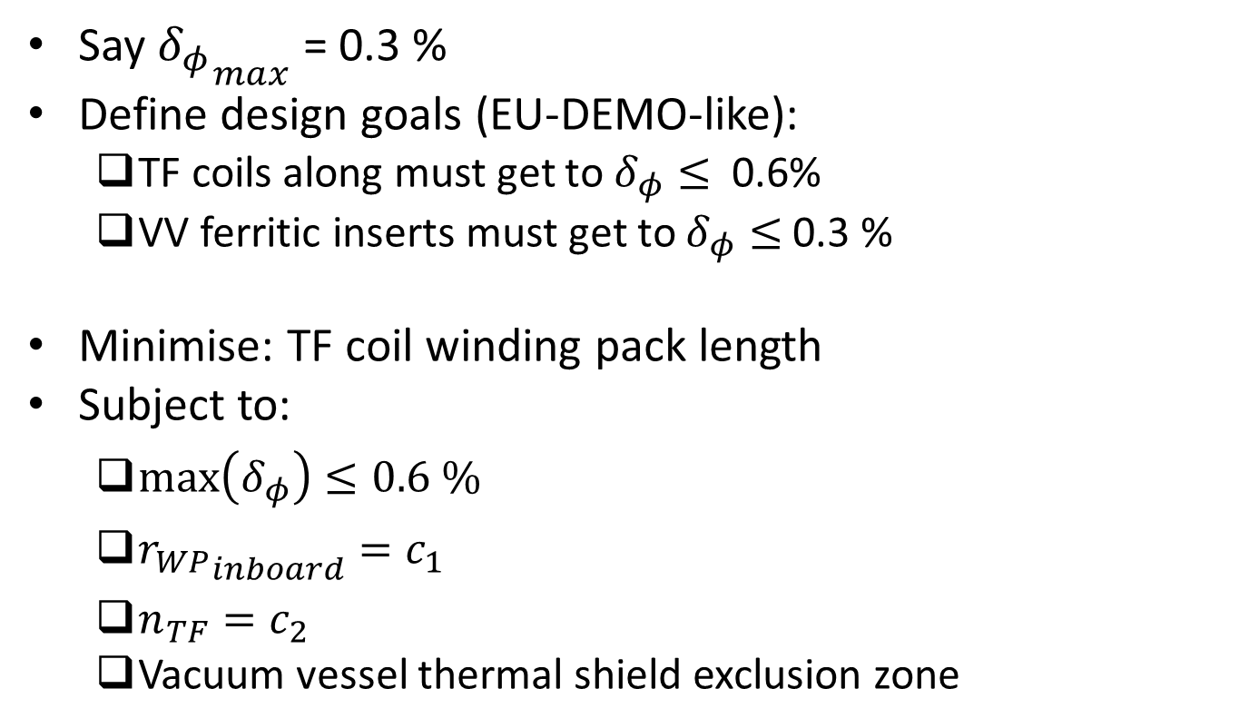
TF coil shape optimisation
Say ${δ_{φ}}_{max}$ = 0.3 %
Define design goals (EU-DEMO-like):
TF coils along must get to $δ_{φ}≤$ 0.6%
VV ferritic inserts must get to $δ_{φ}≤$0.3 %
Minimise: TF coil winding pack length
Subject to:
$\max\left(δ_{φ}\right)≤0.6 \%$
${r_{WP}}_{inboard}=c_{1}$
$n_{TF}=c_{2}$
Vacuum vessel thermal shield exclusion zone

Slide 6
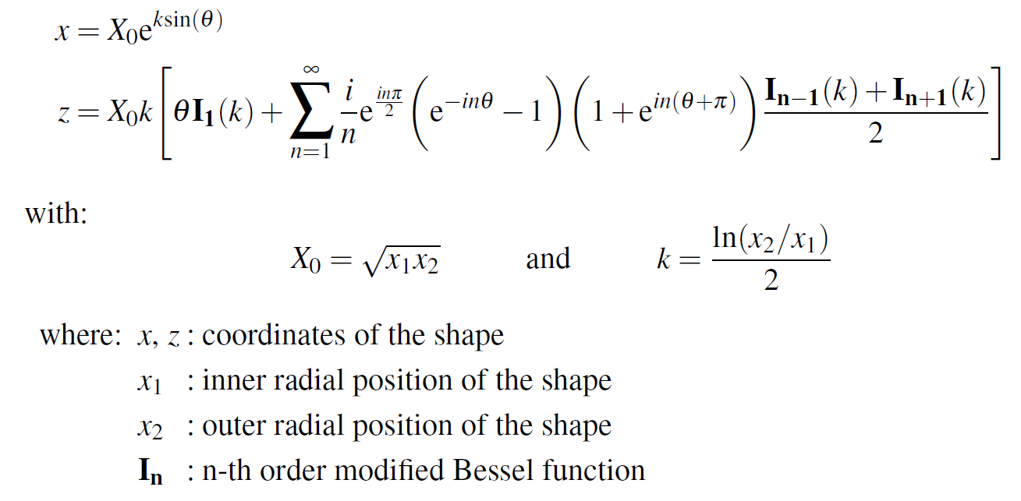
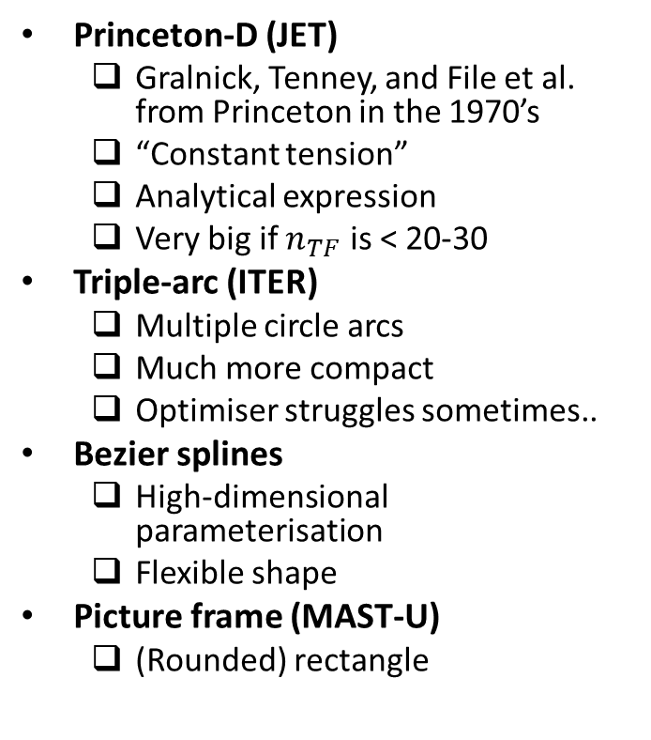
TF coil shapes
Princeton-D (JET)
Gralnick, Tenney, and File et al. from Princeton in the 1970’s
“Constant tension”
Analytical expression
Very big if $n_{TF}$ is < 20-30
Triple-arc (ITER)
Multiple circle arcs
Much more compact
Optimiser struggles sometimes..
Bezier splines
High-dimensional parameterisation
Flexible shape
Picture frame (MAST-U)
(Rounded) rectangle

Slide 7
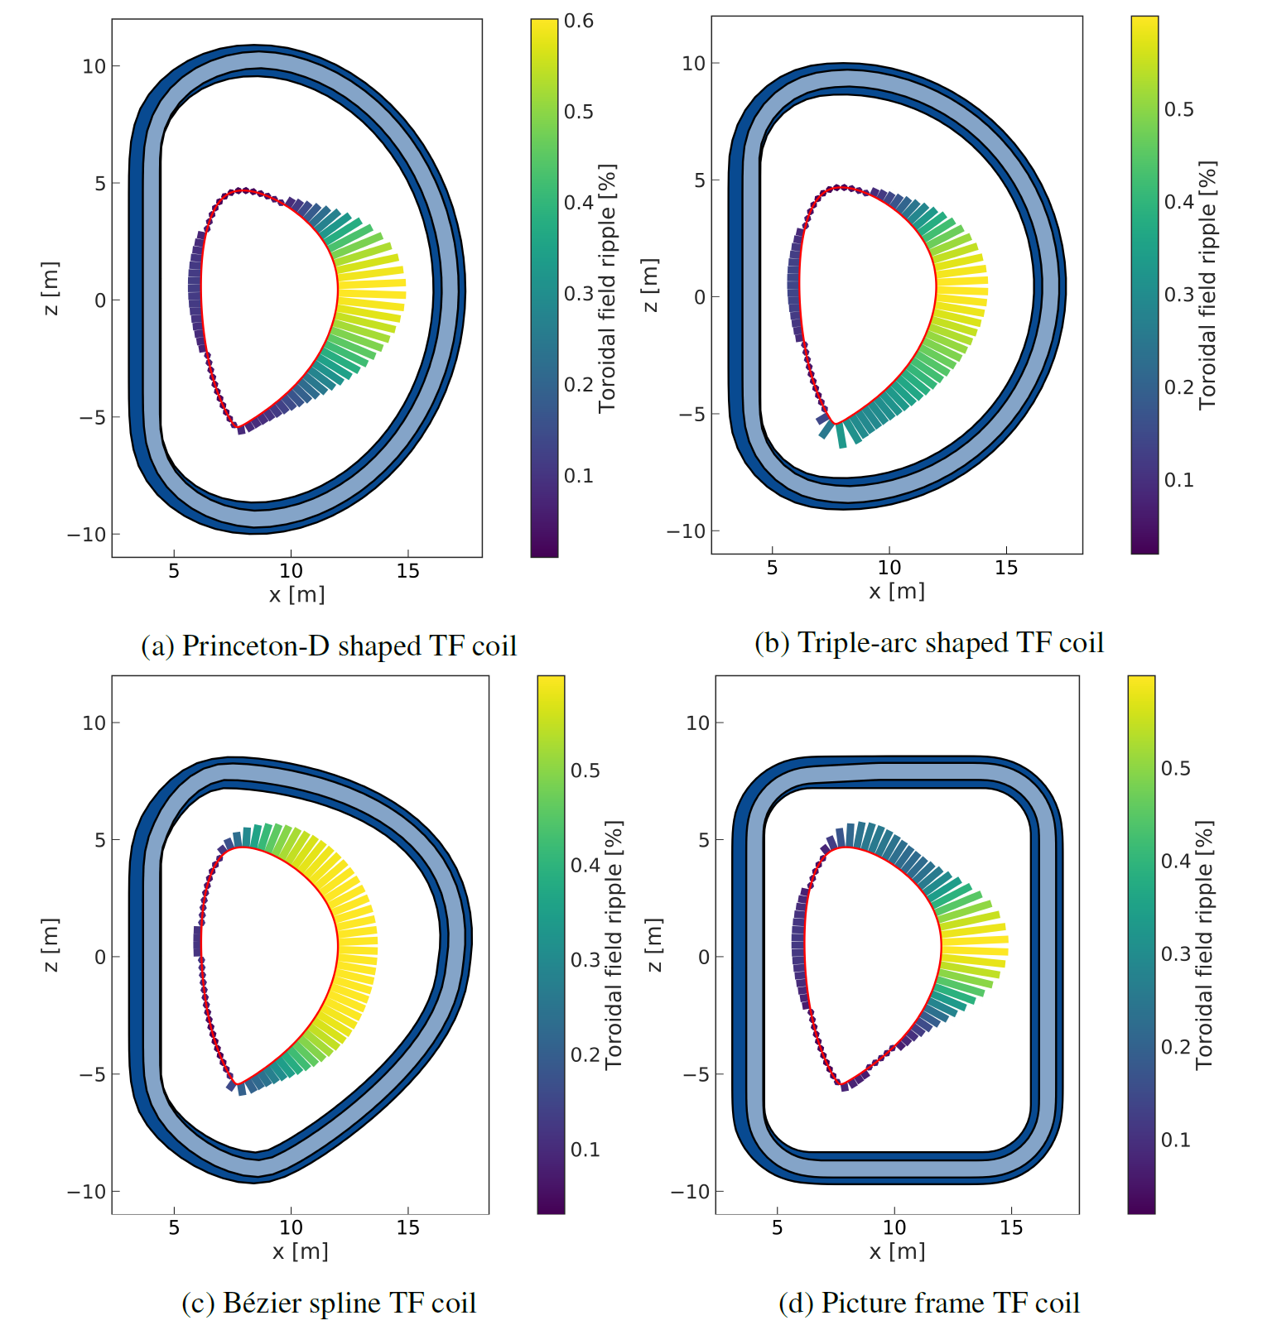
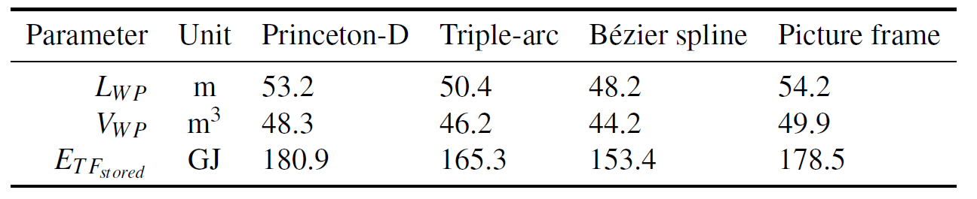
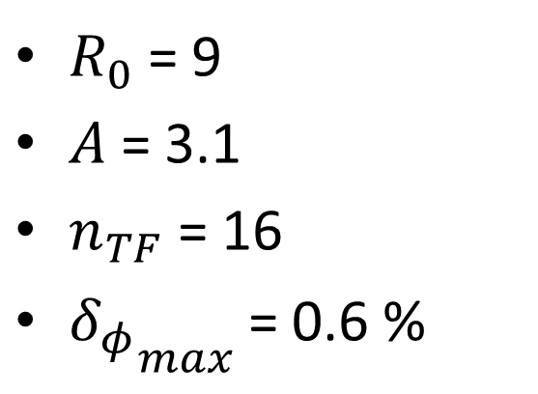
TF coil shape parameterisations
$R_{0}$ = 9
$A$ = 3.1
$n_{TF}$ = 16
${δ_{φ}}_{max}$ = 0.6 %

Slide 8
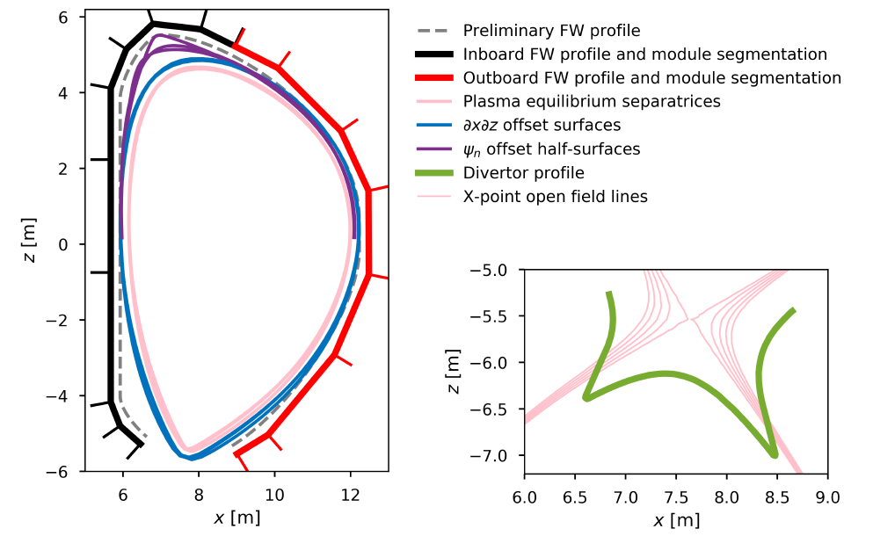
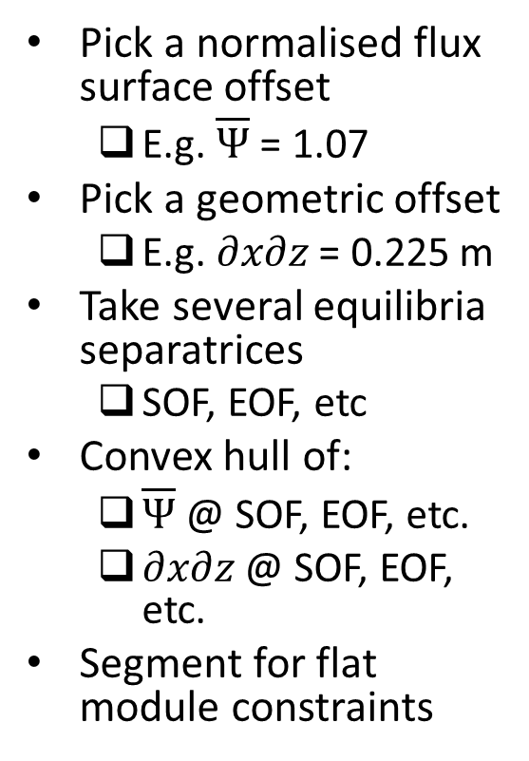
First wall design algorithm
Pick a normalised flux surface offset
E.g. $\overline{Ψ}$ = 1.07
Pick a geometric offset
E.g. $∂x∂z$ = 0.225 m
Take several equilibria separatrices
SOF, EOF, etc
Convex hull of:
$\overline{Ψ}$ @ SOF, EOF, etc.
$∂x∂z$ @ SOF, EOF, etc.
Segment for flat module constraints
Sorry, no time to write up!

